Slide 1

PHASE 2
FINAL PROJECT
EDA & Linear Regression of
King’s County Housing Data

Slide 2

BY: KRISTEN DAVIS
Full-time data science student at Flatiron

Slide 3


IMPORTANT PROJECT NOTE
This deck is intentionally positioned as thought this presentation was being given in 2015

Slide 4
ABOUT THE PROJECT
01
EDA ANALYSIS
02
TABLE OF CONTENTS
LINEAR REGRESSION
03
CONCLUSION
04
FUTURE WORK
05
High level overview identifying goals, stakeholders, & scope
Data insights & visualizations
OLS model to determine housing price
Data driven takeaways for key stakeholders
Areas for further consideration

Slide 5


ABOUT THE PROJECT
01

Slide 6
THE NEED
PROJECTED JOB GROWTH
POPULATION GROWTH
Projected to add at least 115,000 new jobs by 2035
2014 surpassed census projections by 11%
HOUSING MARKET GROWTH
HIGH POVERTY LEVELS
RISE IN RENTALS
%14 percent housing growth from 2000- 2010
The ACS estimates 11% poverty rate
The ACS estimates rentals will be 53% of market by 2018

Slide 7

BUSINESS PROBLEM
In an effort to increase access to quality affordable housing, keep people rooted in their neighborhoods and fight the effect of over development King County and Habitat for Humanity are creating a public private initiative aimed at making data driven decisions to inform house acquisition and repairs in the greater Seattle area.

Slide 8



EQUITY & SOCIAL JUSTICE STRATEGIC PLAN
STAKEHOLDERS
HABITAT FOR HUMANITY
Strategic investment upstream with the aim of expanding access & equity in 8 policy areas including housing.
Nonprofit that builds & preserves houses at a low expense for homeowners to keep people in their communities.

Slide 9

PROJECT GOALS
TARGET ZIPCODES
CHANGEABLE FEATURE ROI
REGRESSION ANALYSIS
Use the sales data to identify neighborhoods areas that are pat risk or over development.
Visualize the effect different features have on home value to understand value add.
Predict future home prices to help guide strategic housing plan & forecast market trends.

Slide 10

EDA ANALYSIS
02

Slide 11
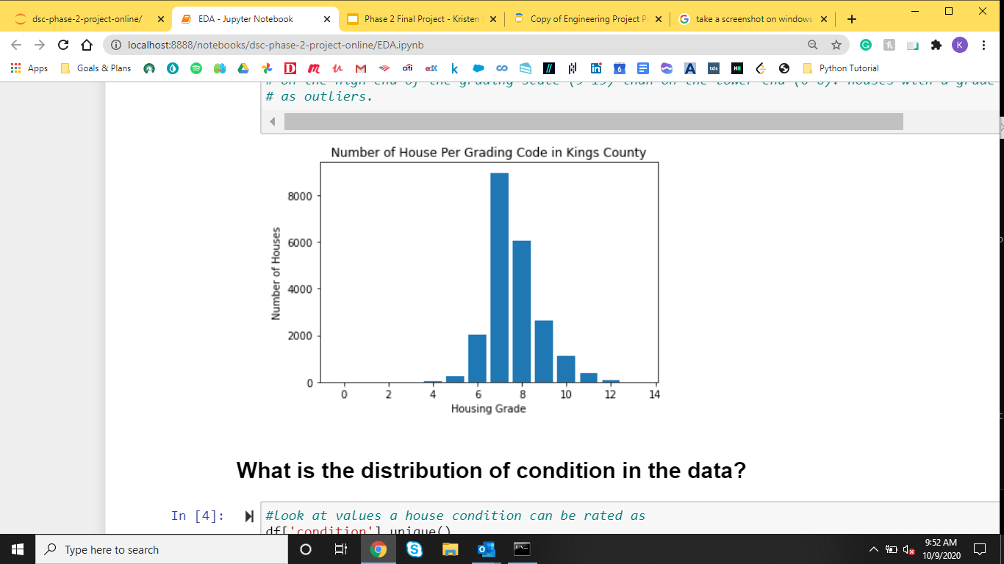
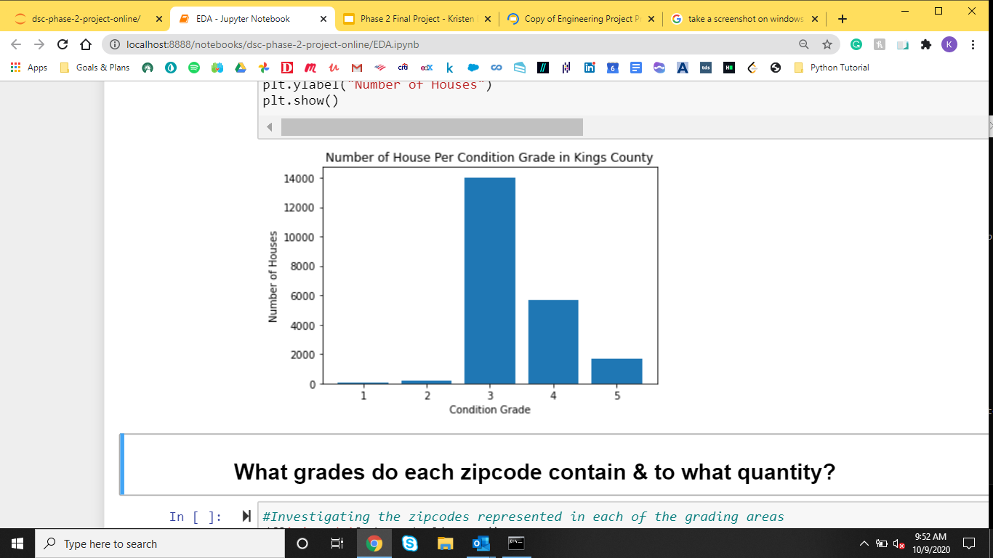
Distribution of Grade & Condition
Indicates average quality of build
Minimum grade to be considered “code compliant”

Slide 12
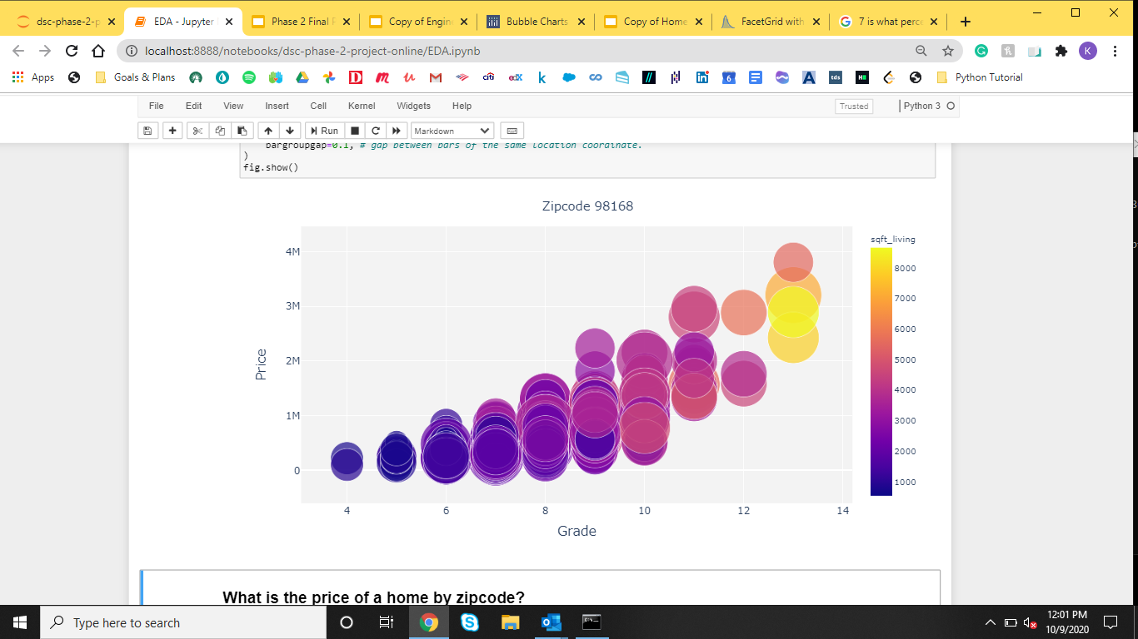
A Picture of Zipcode 98168
Indicates average quality of build

Slide 13
Zipcode 98168 By the Numbers
Sale Price Difference
Ratio of Home to Lot
$1,143,076.19
18%
Average sale price of these homes compared to other homes sold in the zipcode
These homes only occupy about 18% of their total lot sq footage
Low End Sales
Age of Home
24.14%
1937
Of all the poor condition and low grade houses come from this zipcode
Average age of poor conditioned homes
75%

Slide 14

TAKE AWAY:
Homes similar to the these in the zipcode may be at risk for being sold at low value and “flipped” pushing the current residents out of the neighborhood.

Slide 15
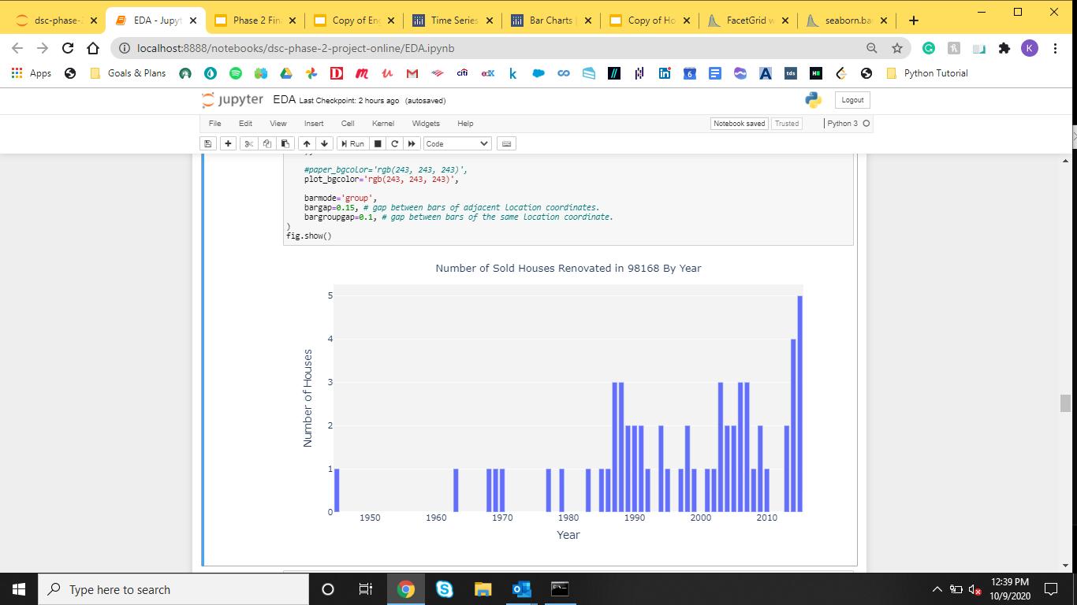
Renovation Visualization
400% Increase

Slide 16

LINEAR REGRESSION
03

Slide 17
Data Transformation
HOUSING GRADE BELOW 11
REMOVE GEOGRAPHICALLY ISOLATED CLUSTER
PRICE BELOW $1 MILLION
LOG TRANSFORM AND NORMALIZE
OLS MODEL
WITHIN 3 STD FROM THE MEAN
DUMMIFIED CATEGORICAL FEATURES

Slide 18
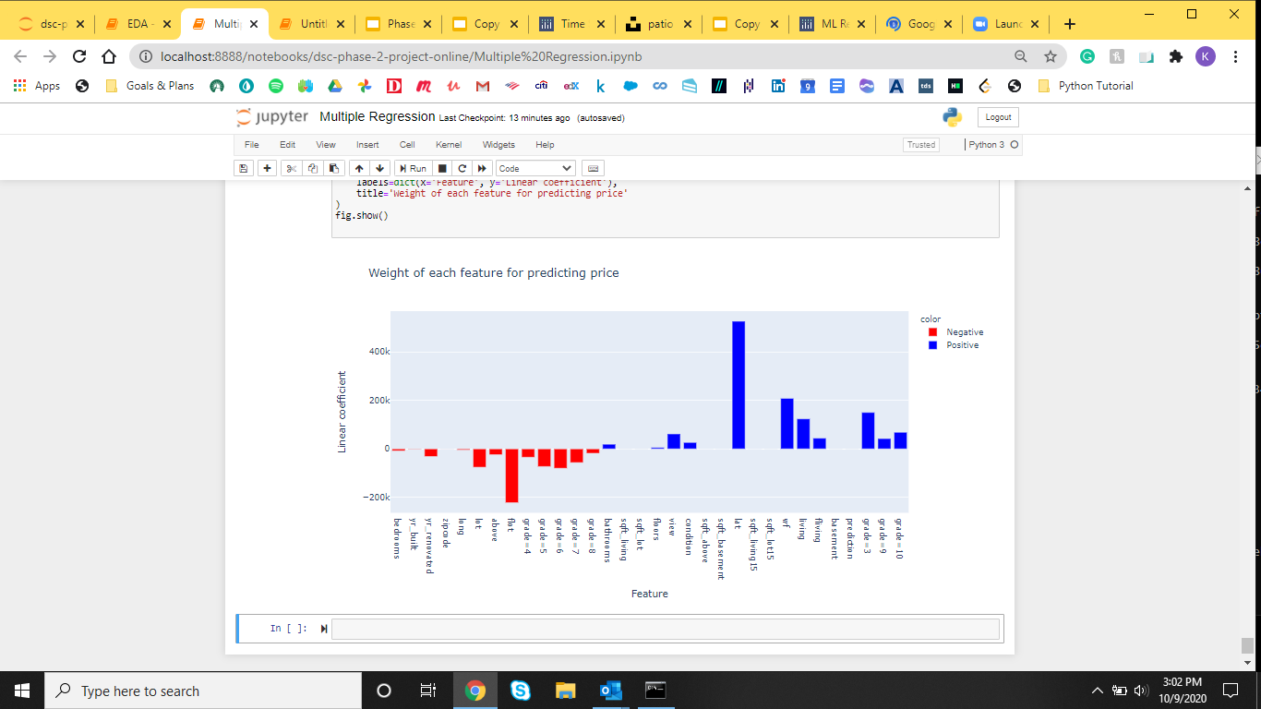
Correlation Between Price and Features in Model:

Slide 19
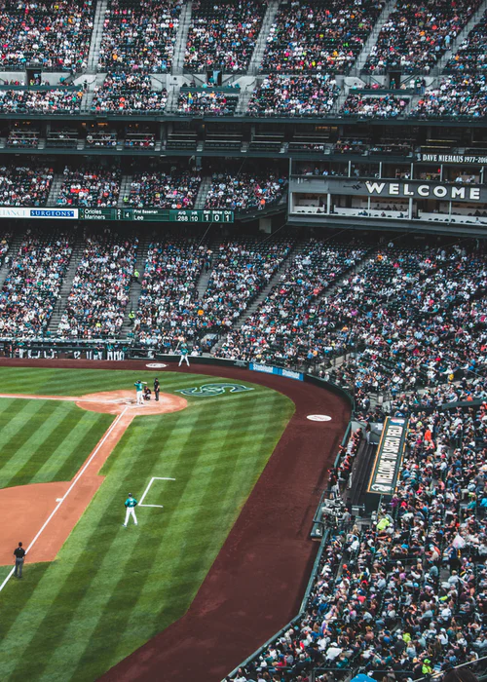
TAKE AWAY:
Linear Model can predict housing price within $151,997.79.
This model uses view, grade, lot square footage, and waterfront visibility.

Slide 20
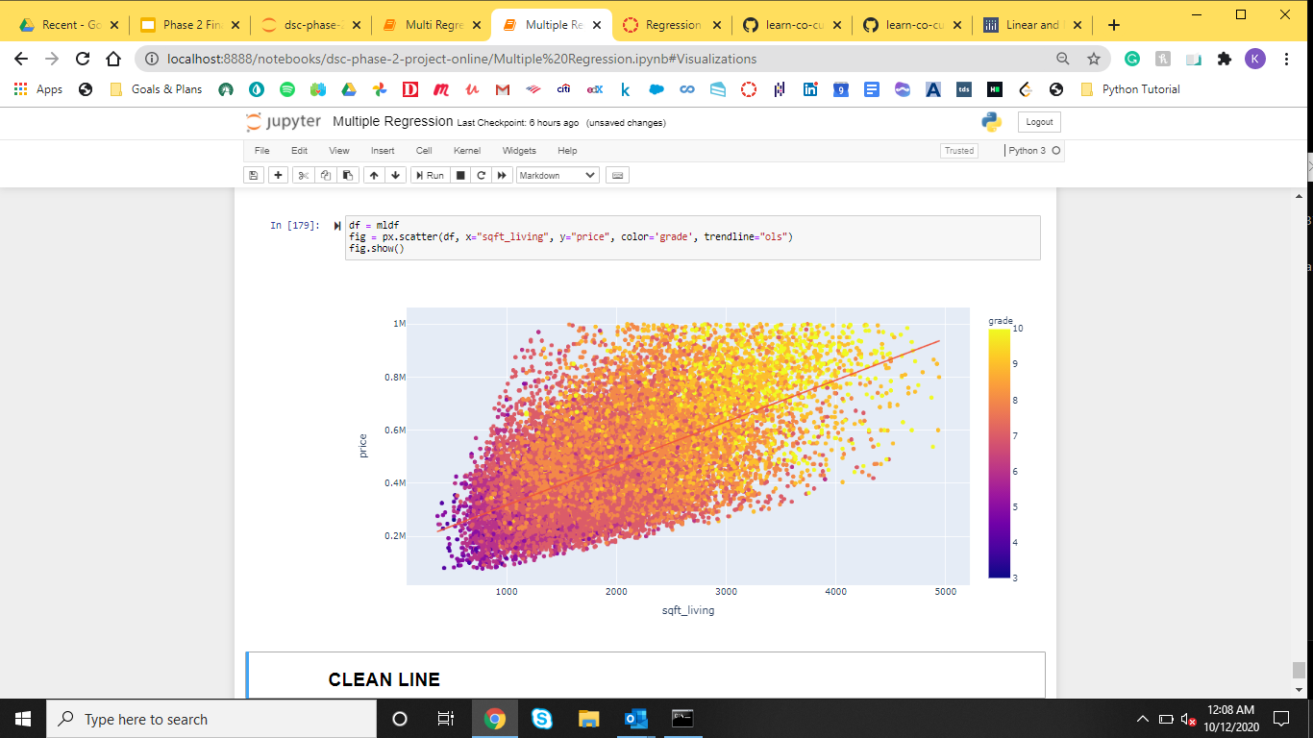
Increase Grade & Sq Footage to Increase Price
I

Slide 21

CONCLUSION
04

Slide 22
TARGET BUY CRITERIA
01
02
Home Has Not Been Renovated
Below or Minimum Code Grade
Home does not indicate extensive renovations
Grade 6 or below on the county grading scale of 0-13
03
04
Within City Limits
Poor Condition of Home
Home falls within the city border
Grade 3 or below on the county grading scale 0f 1 - 6l

Slide 23

FUTURE WORK
05

Slide 24
NEW DATA
A/B TESTING
FUTURE PROJECTS
MODEL REFINEMENT
GEOGRAPHIC CONSIDERATIONS
The King County Website has extensive housing data here
Look at the effect of an additional bedroom or bathroom on price
Continue to iterate over OLS model
Map demographic information with folium.

Slide 25

THANKS
Does anyone have any questions?
Please reach out:
kristendavis27@gmail.com
//
Kristen770 on GitHub

Slide 26
CREDITS
This is where you give credit to the ones who are part of this project.
Presentation template by Slidesgo
Icons by Flaticon
Infographics by Freepik
Images created by Freepik or sourced on Unsplash
Seattle statistics from Seattle.gov

